Slide 1
Intel-Process Communication

Slide 2
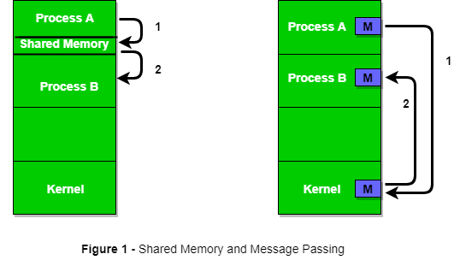
Definition
Inter-process communication (IPC) is a mechanism that allows processes to communicate with each other and synchronize their actions. The communication between these processes can be seen as a method of co-operation between them. Processes can communicate with each other through both: Shared Memory and Message Passing.
It is actually a messaging system for distributed systems.
Notes:
Link: https://www.geeksforgeeks.org/inter-process-communication-ipc/

Slide 3
Need of IPC (Inter-Process Communication)
Large and structured projects have multiple and independent modules.
Modules need to interact with each.
Individual component testing and debugging is easy.
Ways of IPS
Files
Channels (or pipes)
Sockets
Remote Procedure Calls (RPC)
Memory Separation
Notes:
Link: https://medium.com/@konstankino/rabbitmq-for-inter-process-communications-7a2e3ed7ac43

Slide 4
Most Popular tools
Redis (Open-source)
Apache Kafka
Google Cloud Pub/Sub
IBM MQ
Amazon SQS
Azure Service Bus
RabbitMQ (Open-Source)
Notes:
Link: https://www.trustradius.com/products/rabbitmq/competitors

Slide 5
RabbitMQ
Created in 2007 in ERLANG Language
Most widely deployed Message Broker, based on Advance Message Queuing Protocol (AMQP) with standard port 5672.
Support multiple languages e.g. Java, Python, .NET, PHP, Ruby
Python has multiple libraries for integrating rabbitmq
pika
rstream
Rbfly
Aio-pika
Aioamqp
FastStream
Notes:
Link: https://www.rabbitmq.com/devtools.html

Slide 6
Installation Steps
Download and Install ERLANG OTP (exe file)
Download and Install RabbitMQ Server Setup for Windows (exe file)
Download any python library that support RabbitMQ. Our selected example is: -> pip install pika
Enjoy Journey ✨

